Slide 1
How to help your child with Maths
Perhaps the single most important thing that parents can do to help their children with maths is to pass on a positive attitude.
Tanya Byron, Clinical Psychologist

Slide 2
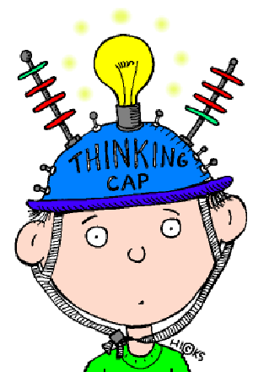
Purpose
To help parents understand Maths at GJS - so you can support your children
To signpost further resources to support you in supporting your child

Slide 3
Fluency & confidence with numbers – Play, play, play!
Games for counting – Ludo, snakes & ladders
Games with money – Monopoly
Card games - Stop the bus, Elevens, Gamewright games etc
Real-life application
Cooking/weighing
Shopping (estimating costs, combining coins, giving change)
Telling the time
Using timetables
“1 minute Maths” app by White Rose – HIGHLY recommended!
Online Maths games
TTRockstars
Hit the Button
Mathsframe
Cool Maths Games

Slide 4
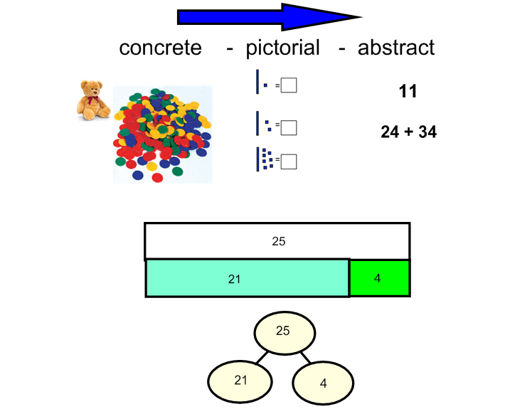
Making sense of schoolwork…
Maths may look very different to how it did when you were at school.
The big change is that rather than just learning methods for working out calculations, children spend a lot more time understanding why these methods work and explaining how they know (reasoning). We use different representations to help us with this. (More on this in a moment!)
As children go through the school, they will also learn to use the formal written methods that you may be more familiar with.
Children are then expected to apply this
undertaking to problem solving. (This is where
your talking about numbers in contexts will be so
helpful).

Slide 5
Making sense of schoolwork…
Representations
Place value grids
Dienes / Base 10
Place value counters
Ten frames
Bar models
Part-part-whole model
Number lines

Slide 6
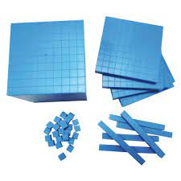
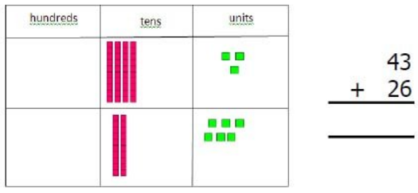
Dienes / Base 10
Dienes are used to secure children’s understanding of place value.
We use dienes to show what happens when we add and subtract across columns as a stepping stone to using formal written methods.

Slide 7
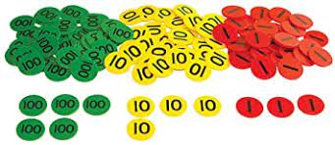
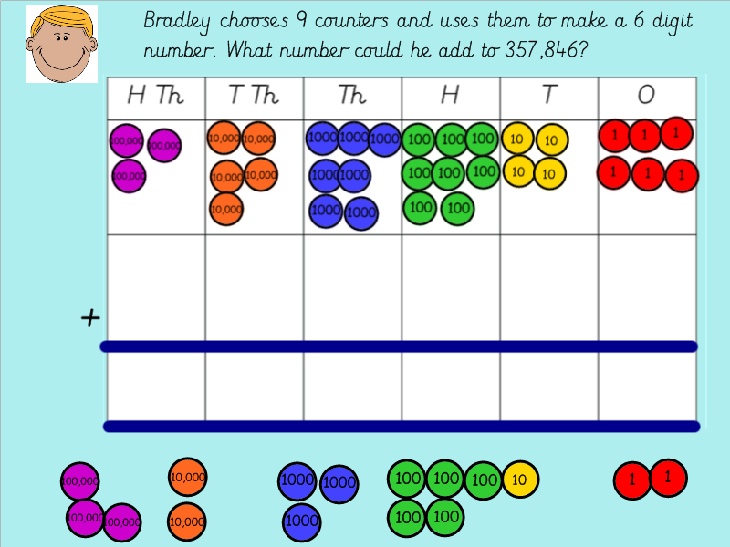
Place value counters
Place value counters are another resource used to help children’s understanding of place value.
We use dienes and place value counters along with place value grids.
They may be seen in problems as well!

Slide 8
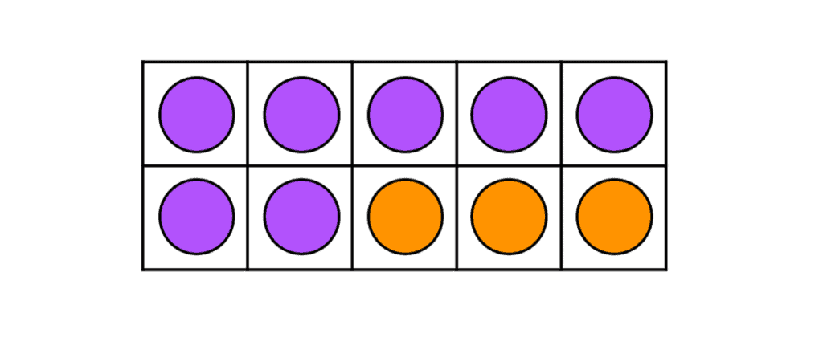
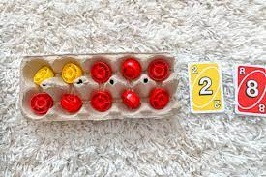
Ten frames
Used to model number bonds to 10, to 100, to 1000 and in decimals and tenths
Egg box ten frames can be useful to secure number bonds if they are insecure.
Supporting questions might include:
How many counters do I have? How many more do I need to get to 10? If I had ten and I took 3 away, how many would I have left?

Slide 9
Bar models
Bar models are where pictures of bars are used to represent calculations and word problems.
They are used for all four operations.
They do not “solve” problems, but can help children visualise what the problem is and then how to solve it.
This bar model could be used to represent addition or subtraction.

Slide 10
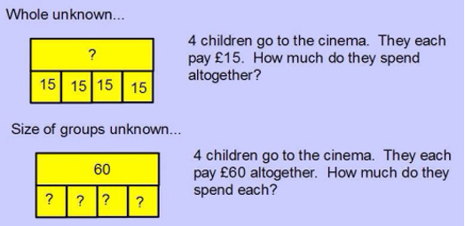
Bar models
The Bar Model Company has some videos here:
https://www.youtube.com/channel/UC5gj9_s0Tibd1C8HW5aOkaQ/videos

Slide 11
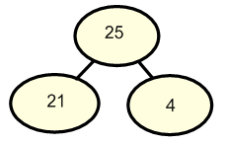
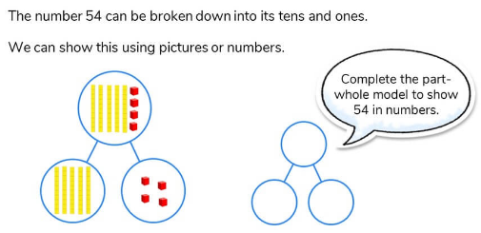
Part – part - whole
A part-whole model is a useful diagram that shows a number split into parts.
Children may be asked to find missing values in a part-whole model in problem solving.

Slide 12
Children may be asked to find missing values in these representations. They may then use formal written methods to solve the problem.
?
17 | 17 | 17 | 17 | 17
?
4.5
4.5
4.5

Slide 13
Number lines
Initially, number lines will be marked.
Support for mental methods
+20
+6
+2
34
54
60
62
34 + 28 =
20
8
6
2

Slide 14
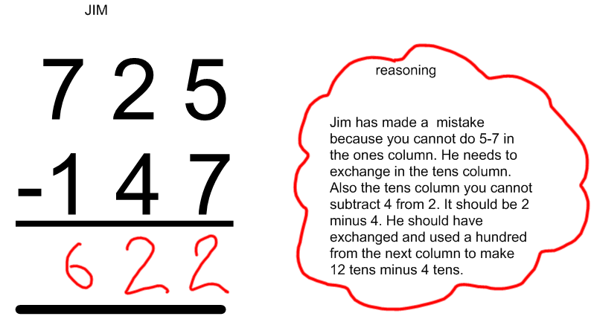
Reasoning
This way of working builds a deeper understanding of how numbers are put together. This then supports children in being able to reason mathematically.

Slide 15
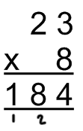
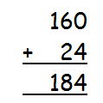
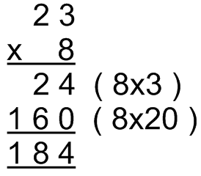
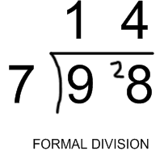
Formal written methods
Column methods for addition and subtraction
Multiplication and division may show “expanded” methods initially

Slide 16
Year 4 times tables check
Fluency in times tables IS very useful for children to develop. As they go up the school, it helps them with multiplication, division and fractions.
Repetition, games and songs can all help develop a more secure recall of times tables.

Slide 17
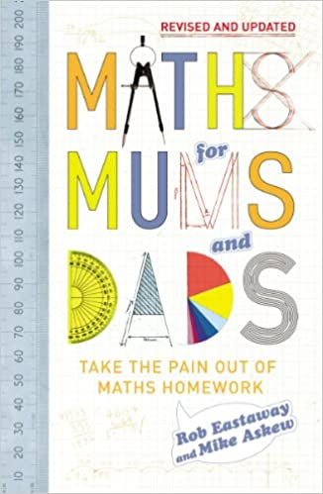
Further resources
GJS Maths Calculation Policy
(GJS website, About the school/Policies/Maths Calculation Policy)
Home Learning | White Rose Maths
White Rose “Home Learning” video lessons:
Book: Maths for Mums and
Dads
Online games:
TTRockstars
ttrockstars.com
Hit the button:
https://www.topmarks.co.uk/maths-games/hit-the-button
Maths frame
mathsframe.co.uk
Cool Maths Games:
https://www.coolmathgames.com/

Slide 18
Most of all, try to make Maths fun and meaningful!
Perhaps the single most important thing that parents can do to help their children with maths is to pass on a positive attitude.
Tanya Byron, Clinical Psychologist

