Slide 1
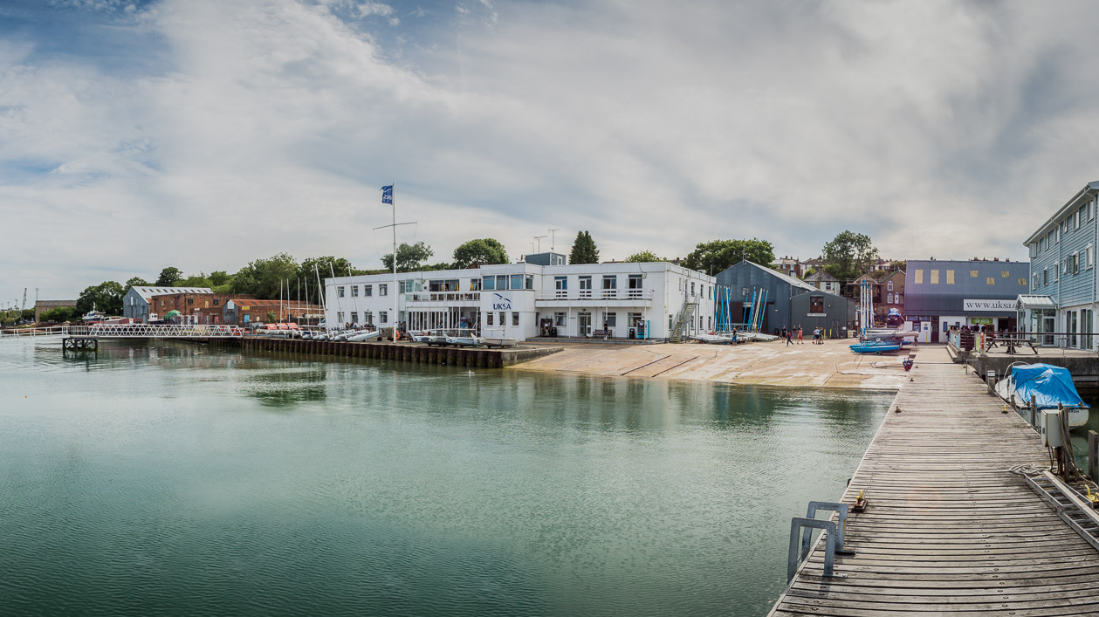
Year 6 Residential - UKSA
16th – 20th September 2019

Slide 2
Purpose of the Evening
Recap aims
UKSA Centre
Who is going
Itinerary
Kit list and essentials
Leaving/returning
Any Questions

Slide 3
Why we are going?
To develop teamwork skills with a range of different people in different situations.
To raise self esteem through challenging activities.
To promote the principles of outdoor education.
To promote health and fitness.
To develop safety awareness and equip children to recognise risk.
To enjoy a memorable experience.

Slide 4
Where are we going?

Slide 5
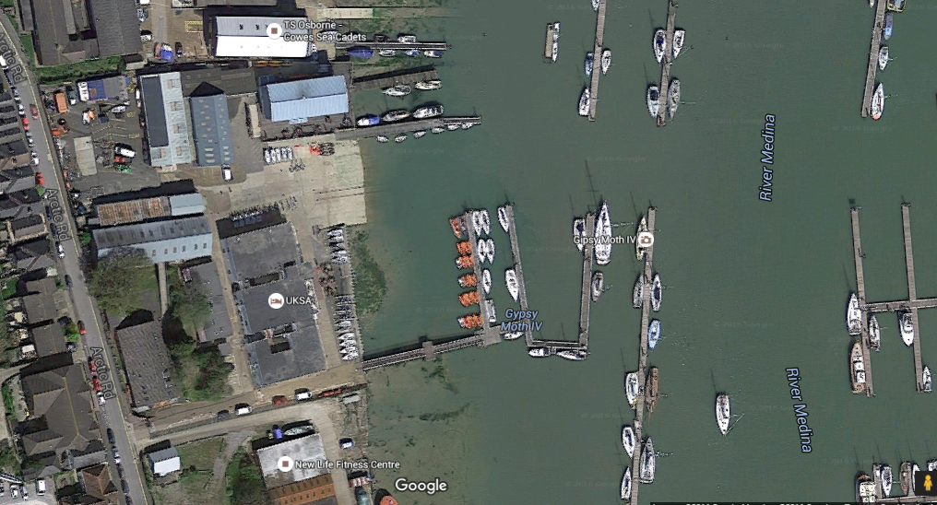
UKSA Centre

Slide 6
UKSA Centre
Supporting, empowering and educating young people by introducing them to the fun, challenge and rewards of residential water sports.
Well organised trip
Accommodation right by the water
Trained Instructors
Food – options, options, options…
A fitting beginning to life in Year 6
www.uksa.org

Slide 7
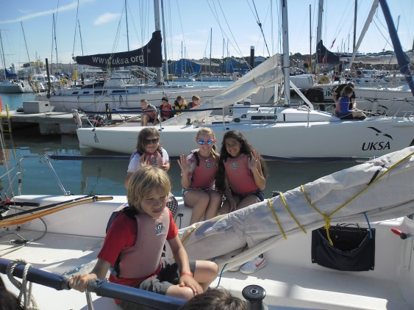
Accommodation
Children sleep in rooms of 6-8
Rooms are allocated based on friendship groups - September
Separate girls and boys rooms
Staff are situated in the same corridors

Slide 8
Who is going?
CHILDREN:
Mr Jonathan Poole (Trip leader)
Miss Holcombe
Mrs Jan Nash (Medical)
Mrs Katherine Frogley
Mrs Katey Ayshford
Mr Adam Samson (Deputy trip leader)

Slide 9
Groupings
Children will be put into 2 groups:
1. Activity Group
2. Dorm Group (children to be with at least one of their chosen friends – Bump Up Day)
All other times they can be with who like.

Slide 10
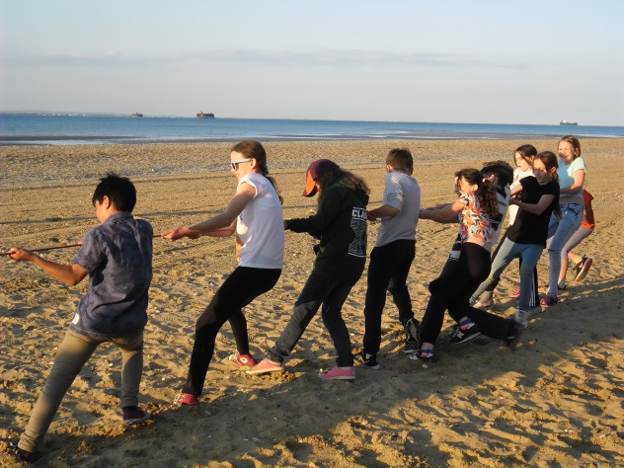
Timetable
Morning, afternoon and evening activities
9.00am Morning sessions begin
1.00pm Afternoon sessions
6.30pm Evening sessions begin at
9:00pm Bedtime
9:15 – 9:30pm Lights out
9:31pm Sleep

Slide 11
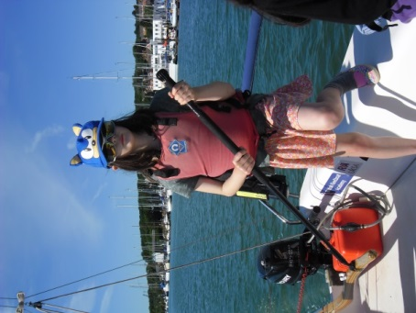
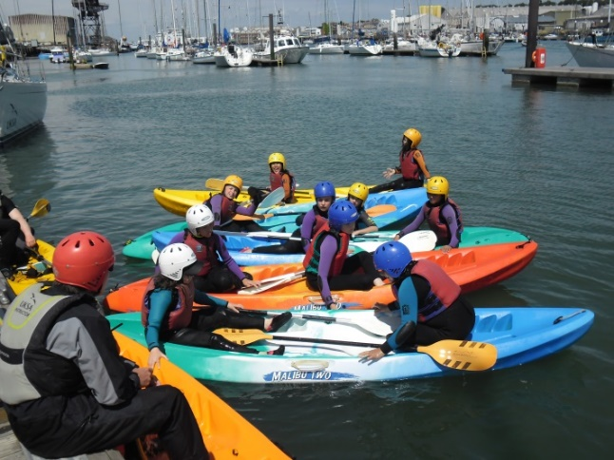
Activities
Check our blogs on our website each evening
On the Water
Evening Activities
Water Games
Dinghy sailing
Kayaking
Raft building
Stand Up Paddle Boarding
Keel boating
Team Games Challenges
Cinema
Swimming

Slide 12
Activities
Check our blogs on our website each evening
On the Water
Evening Activities
On the River Medina.
Water Games
Dinghy sailing
Kayaking
Raft building
Stand Up Paddle Boarding
Keel boating
Team Games Challenges
Cinema
Swimming

Slide 13
Activities
Check our blogs on our website each evening
On the Water
Evening Activities
Water Games
Dinghy sailing
Kayaking
Raft building
Stand Up Paddle Boarding
Keel boating
Team Games Challenges
Cinema
Swimming
On the water by UKSA

Slide 14
Activities
Check our blogs on our website each evening
On the Water
Evening Activities
Water Games
Dinghy sailing
Kayaking
Raft building
Stand Up Paddle Boarding
Keel boating
Team Games Challenges
Cinema
Swimming
Larger boats on the Solent

Slide 15
Activities
Check our blogs on our website each evening
On the Water
Evening Activities
Water Games
Dinghy sailing
Kayaking
Raft building
Stand Up Paddle Boarding
Keel boating
Team Games Challenges
Cinema
Swimming

Slide 16
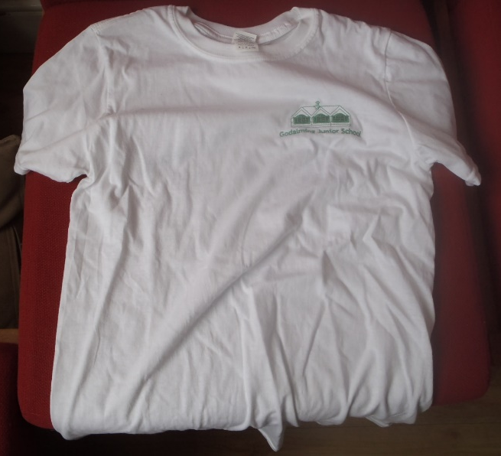
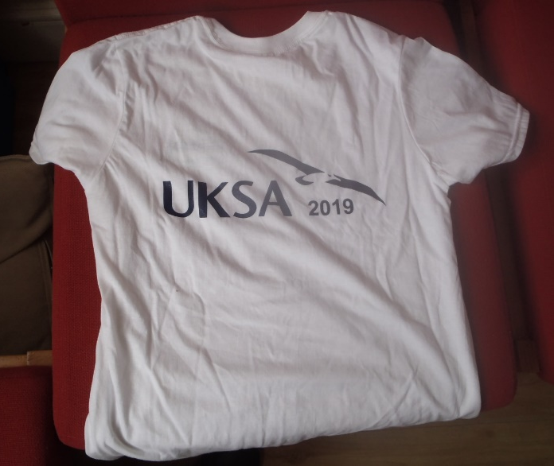
Kit List

Slide 17
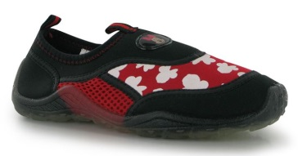
Kit List
Provided:
Wetsuit
Splash suit
Buoyancy Aid
Helmet

Slide 18
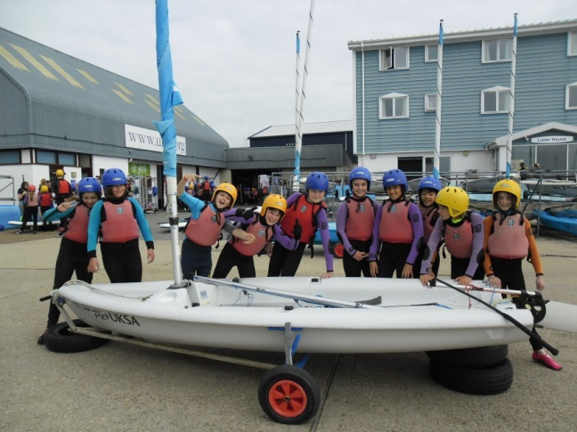
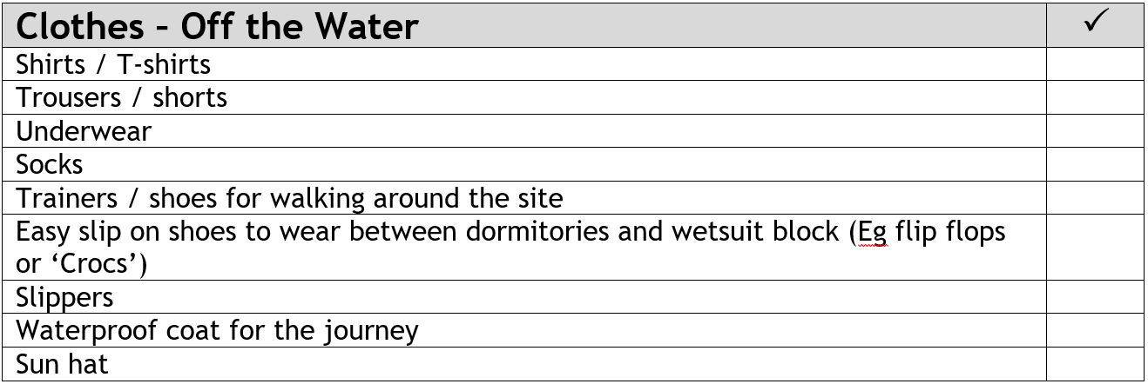
Kit List

Slide 19
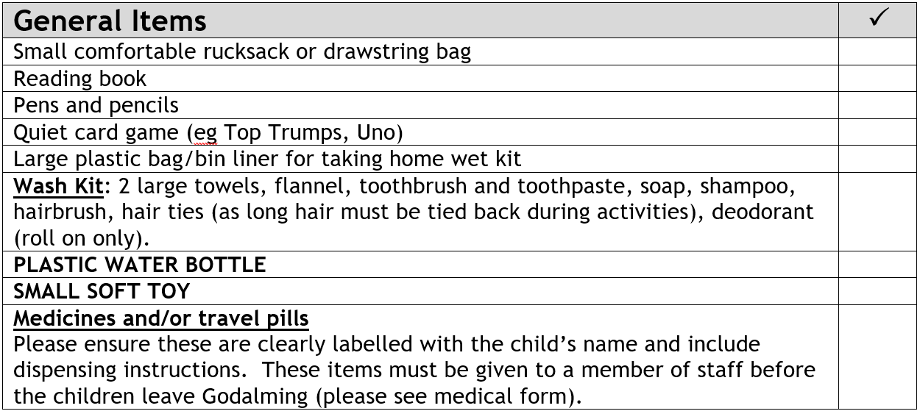
Kit List

Slide 20
Kit List

Slide 21
Leaving
Please arrive between 8:00 - 8:15am
We will be meeting on the front playground (in the dining hall/music room if wet)
Your child should have ONE LARGE BAG for the week
ONE SMALL ‘DAY’ BAG containing:
Packed lunch
Drink
Jumper and coat
School uniform will not be required.
On arrival, please:
Sign in at registration desk
Hand in any medication to Mrs Nash
Place bags (lunch bag and large bag) against the small wall by the hedge at the front of the playground
Nip to the loo

Slide 22
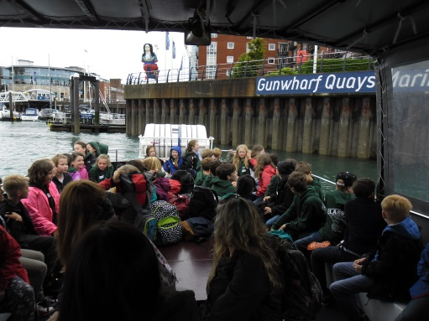
The Journey
Leaving school at 8.30am
When ready to depart, children will:
collect both bags
line up in classes (final check)
walk with both bags to the coach outside ‘Harry’s’.
Drop off large bag to be loaded on to coach. KEEP SMALL BAG WITH THEM
Journey to UKSA by coach to Gunwharf Keys (Toilet Stop)
Catch a ‘Jenny Boat’
An hours trip – early lunch.
We will text out to announce arrival.

Slide 23
While we are there
Expectations
Representing the School – GJS Away
Expectations stay the same
Wight Points
Reward System while we are away
Prizes for
Top 3 Wight Points
Dorm Inspections!

Slide 24
Returning
Estimated time of return: 3:30pm in the Front Playground of the school.
Please check Parentmail/texts regularly in case of changes.
WHEN COLLECTING YOUR CHILD FROM THE PLAYGROUND ON THE FRIDAY, PLEASE SIGN OUT WITH YOUR CLASS TEACHER SO WE KNOW EVERYONE HAS GONE HOME SAFELY.
For a quicker exit:
Help to get cases off the coach and line them up by the wall in the playground.

Slide 25
Reminder - forms
Medical forms and provision of medicines
Emergency contacts
Dietary requirements

Slide 26
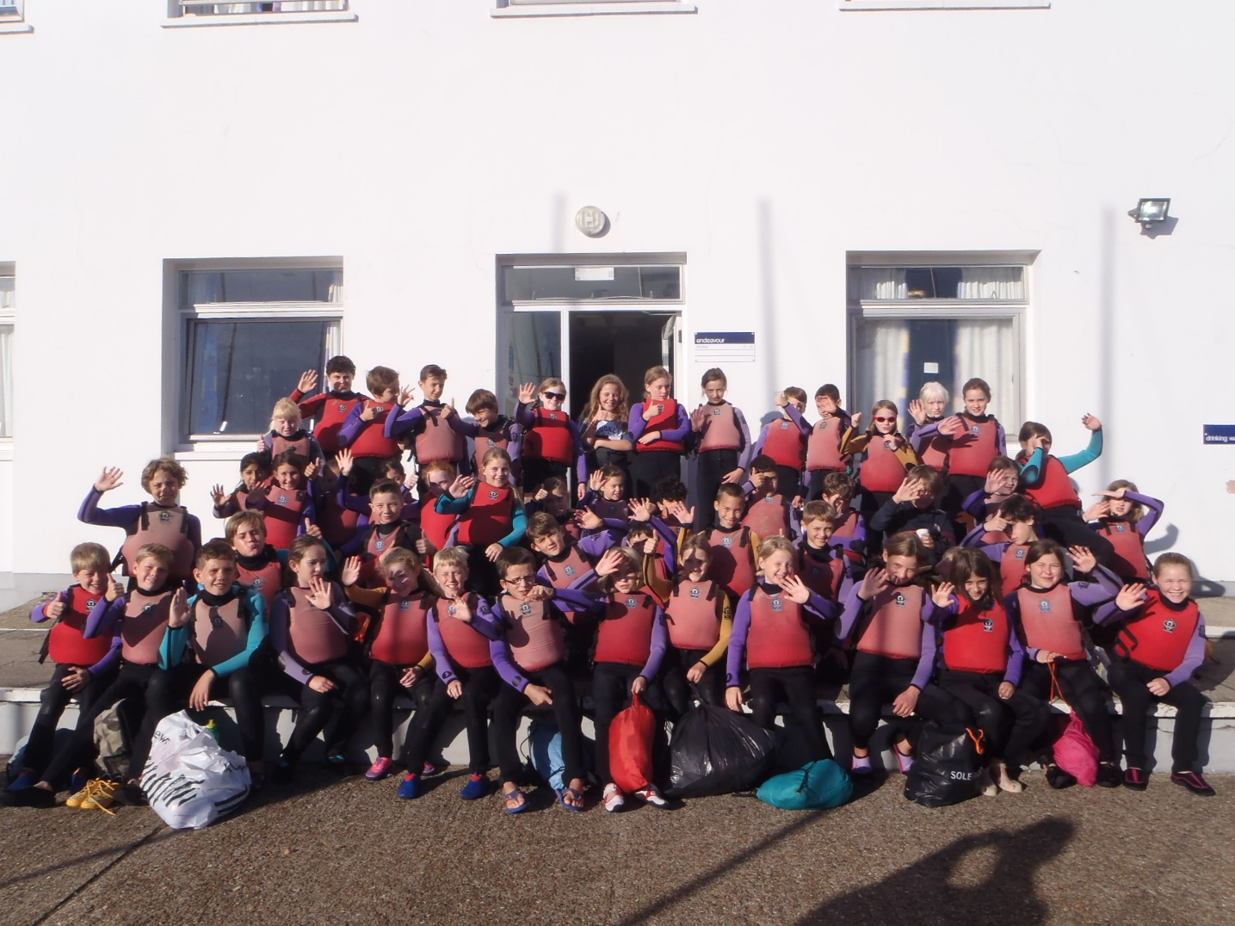
Any Questions?

