Slide 1
Year 4 Visit to Sayers Croft Friday 18th- Sunday 20th May 2018
Notes:
AS

Slide 2
Tonight…
Why Sayers Croft?
Who’s coming?
How do we get there?
What does our day look like?
What are we doing there?
What happens at night?
What do we need to bring?
What do I need to remember?
Last year…
What are the children looking forward to?
Any other questions?
Notes:
AS

Slide 3
Why Sayers Croft?
Local- well established with great reputation
“Sayers Croft is a beautiful, safe site that has been providing quality outdoor experiences for young people for over 70 years.”
Gives children the chance to spend a short time away from home before the year 6 residential.
Range of outdoor activities bespoke to our curriculum (History, Geography, PE and Science).
Notes:
TT

Slide 4
Who’s Coming?
Miss S. Dlugokecka (Class teacher)
Miss E. Martin(Class teacher)
Mr A. Samson (Head teacher)
Miss R. Pulleyn
Mrs J. Nash (TA)
Miss V. Blacklidge (TA)
Mrs L. Munz (Burser)
Mrs R. Samson
Notes:
Thank you for those that volunteered to help with this trip. TT

Slide 5
How do you get there?
Children can be picked up from school from 2:00pm.
Children to be dropped off at 3:30pm at Sayers Croft.
Children to be picked up at 1:30pm on Sunday from Sayers Croft.
Please car share where possible.
Please see us if there are any problems
Notes:
SD- remind parents that there will be noone to supervise the children before that time.

Slide 6
What does our day look like?
Breakfast - 8:00am
Morning activities -9:30am
Lunch - 12:30pm
Afternoon activities -1:30pm
Free Time- 4:00pm
Dinner - 6:00pm
Evening activities -7:00pm
Bedtime – 9:15pm
Lights out - 9:45pm
Notes:
SD

Slide 7
What are we doing there?
Challenge Course and Team Challenges
Orienteering
Pond Dipping
Saxon themed Round House experience
Shelter Building
Dopey Dormouse science investigation
Bouldering
Night walks
Notes:
TT

Slide 8
What happens at night?
2 Dormitories- Peaslake and Rudgwick.
One class per dormitory.
Separate girls room and boys room.
3 adults per dormitory.
Common room/ class room per dormitory.
Notes:
TT

Slide 9
Safeguarding
EVOLVE approved OAA site
All staff and helpers have DBS clearance
Fire drill on arrival
All staff stay on site – within dormitories
24 hour patrols – number given to staff on arrival
Alarms and emergency lighting
Each dormitory is locked – teacher will be key holder
Sleep Walker Alarm on external doors
Staff mobile phones
Risk assessments for all activities
Behaviour Policy applies at Sayers Croft
Notes:
AS

Slide 10
What do I need to bring?
Please ensure ALL items are labelled as children will need to unpack.
Please ensure you supply old clothes that you do not mind getting muddy.
Sturdy covered shoes for outside and slippers/ sandals for inside.
No electronics (including kindles, mobile phones and tablets).
No aerosol cans allowed on site.
Please clearly label all medication with name and dosage and hand in to your child’s class teacher on arrival.
Notes:
Children should be able to carry their own stuff SD

Slide 11
What do I need to remember?
Please return your medical forms by Monday 23rd April if you have not already done so. Spare copies are available at the back if needed.
Please be aware, the final date for payments has now passed. Any outstanding amounts should be paid as soon as possible.
Notes:
You may want to stay behind tonight and complete them here…SD

Slide 12
Last Year…
Falling off the challenge course was really fun- the coach made it seem real
Staying in dorms with our friends was great fun
I enjoyed finding big creatures in Pond Dipping
We loved smelling the different pots during the Saxon round house!
The food was amazing- we all got as much as we needed!
Finding our way around the site while orienteering was fun
I WOULD RECOMMEND IT TO EVERYONE!!!
The Sayers Croft staff are really friendly!
Notes:
TT

Slide 13
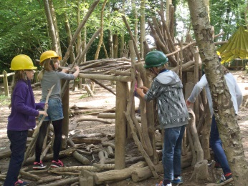
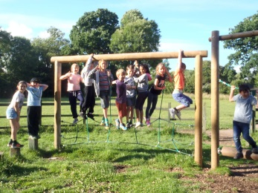
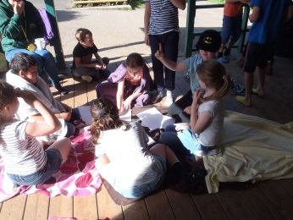
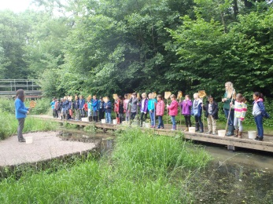
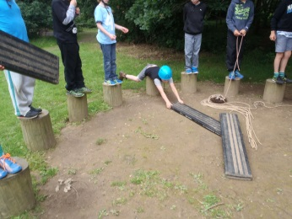
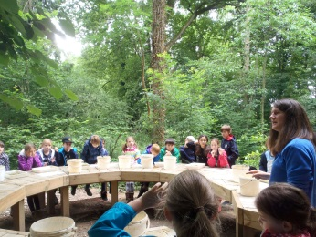
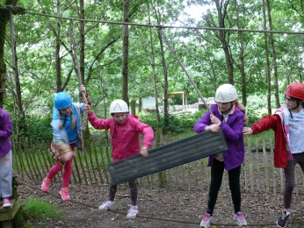
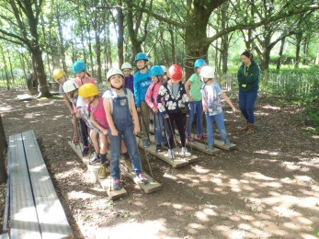
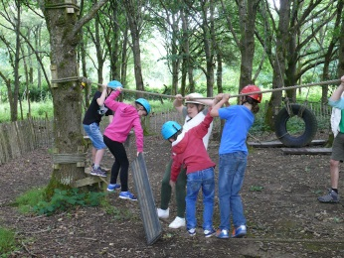
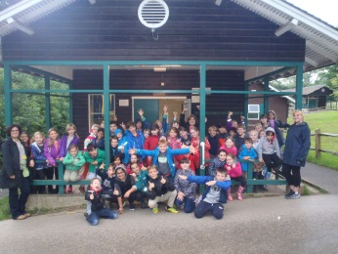
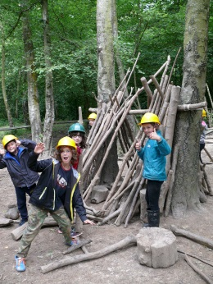
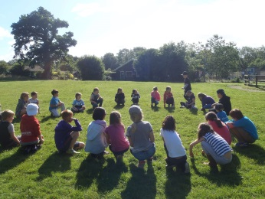
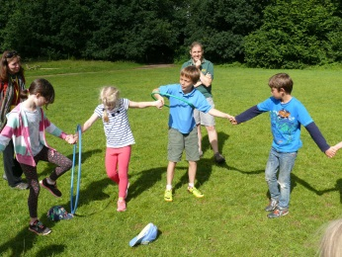
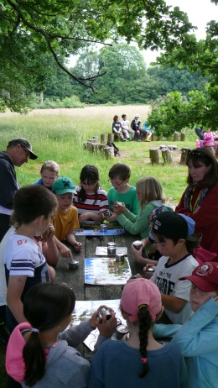
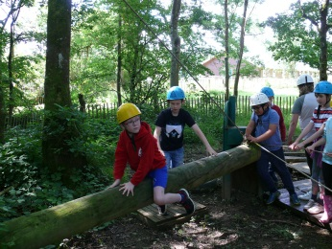
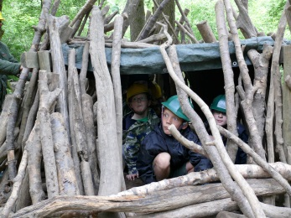
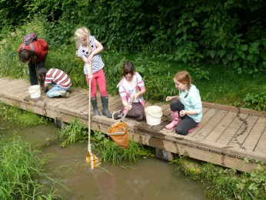
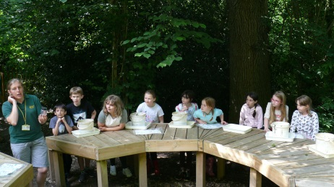

Slide 14
What are the children looking forward to?
I’m looking forward to staying in bunk beds!
I’m looking forward to orienteering!
I’m looking forward to the different activities!
I’m looking forward to staying up later!
I’m looking forward to seeing different animals!
I’m looking forward to spending time with my friends!
I’m looking forward to trying new things!
I’m looking forward to the bouldering!
I’m looking forward to everything!
Notes:
TT

Slide 15
Thank you for coming!
Staff will be around if you have any questions or queries
Notes:
TT SD

