Slide 1
End of Key Stage SATs Information Afternoon

Slide 2
Outline
End of Key Stage SATs Information Afternoon
SATs Timetable
Explain the different tests
Show example question types
Ways that you can help
How the tests are administered
Look at the sample tests from previous years
Answer any questions about the tests

Slide 3
SATs
End of Key Stage SATs Information Afternoon
SATs Tests - Not just a test on the children’s final year at school but questions come from the curriculum in all year groups at KS2.

Slide 4
The Week 13th May 2019
MONDAY | English Grammar, Punctuation and Spelling Test 9:15am 45 minutes
 | Spelling Test 10:45am No strict time limit. - Approx 15 minutes
TUESDAY | Reading Test 9:15am 1 hour
WEDNESDAY | Maths Paper 1 - Arithmetic Test 9:15am 30 minutes
 | Maths Paper 2 - Reasoning 10:45am 40 minutes
THURSDAY | Maths Paper 3 - Reasoning 9:15am 40 minutes.
End of Key Stage SATs Information Afternoon

Slide 5
SATs Week
End of Key Stage SATs Information Afternoon
Tests will be conducted in classrooms and the group rooms around the school including the art room.
Normal timetable is changed for all Year 6 pupils.
Additional or extended breaks.
Additional staff will be deployed to support children.

Slide 6
MONDAY English Grammar, Punctuation and Spelling
End of Key Stage SATs Information Afternoon
Paper 1- 45 minutes
The questions are very much like the questions they have been answering on spag.com for homework. Questions get progressively more difficult.
50 marks
Paper 2 – Spelling - no time limit
The children will have 20 unrelated sentences on their sheet with one ‘blanked’ out word in each. The words come from KS2 spelling rules and word list from curriculum. Any year group.
In the test, the teacher will:
say the word that is missing
say the whole sentence it is in to put the word in context
repeat the missing word again
Scores are combined

Slide 8
TUESDAY Reading – 1 hour
End of Key Stage SATs Information Afternoon
The children will read a booklet - 3 different and unrelated types of text (e.g. non-chronological report, a story, a letter, a poem…)
Answer questions based on what they have read one text at time. Pacing skills needed.

Slide 9
Pages from the Sample Reading Test
End of Key Stage SATs Information Afternoon

Slide 11
Ways to help at home
End of Key Stage SATs Information Afternoon
Reading
Listen to your child read – fluency.
Read a range of non-fiction, fiction and poetry texts – identify the features of the texts.
Answering questions that involve retrieval skills – skimming and scanning skills.
Answering questions with evidence from the text.

Slide 12
Questions to ask
End of Key Stage SATs Information Afternoon
What does the word _______ suggest about _______?
What does this word mean?
How can you tell that …?
What impressions of _______ do you get?
Why did _______ happen?
What evidence is there of/that _______. Give two points.
In what ways might a character be perceived or ‘appeal to readers’?
How do you know that?

Slide 13
Maths – Arithmetic (30mins)
End of Key Stage SATs Information Afternoon
Approximately 36 numerical questions (e.g. 5.6 x 8) to answer in 30 minutes.
No worded questions.
The questions will range from simple multiplication to division of fractions.
Long multiplication and division questions are worth 2 marks. However a correct answer would gain 2 marks regardless of working out. 1 mark would for a correct long mult/div working but with one error.

Slide 14
End of Key Stage SATs Information Afternoon

Slide 15
Maths – Reasoning Papers (x2) 40 minutes each
End of Key Stage SATs Information Afternoon
No difference in difficulty between the 2 papers.
Worded questions involving thinking/reasoning skills. They might involve explaining how they got their answer or have to take multiple steps to get to the answer.
Some questions will require detailed working out before obtaining the answer, i.e. more 2 or 3 mark questions.

Slide 16
End of Key Stage SATs Information Afternoon

Slide 17
Ways to help at home
End of Key Stage SATs Information Afternoon
Many questions involve solving a problem and working in context. Ask questions about the world around them, involving:
Times tables - TTRockstars
Telling the time, differences in time, reading bus and train timetables, T.V schedules, cooking times, 12 and 24hr clock etc.
Measuring, estimating, checking – length, area, capacity/volume, mass/weight, temperature (positive/negative), angles etc.
Money, shopping bills, change, tickets etc.
Working out fractions and percentage of quantities.
HOW DO YOU KNOW?

Slide 18
End of Key Stage SATs Information Afternoon

Slide 19
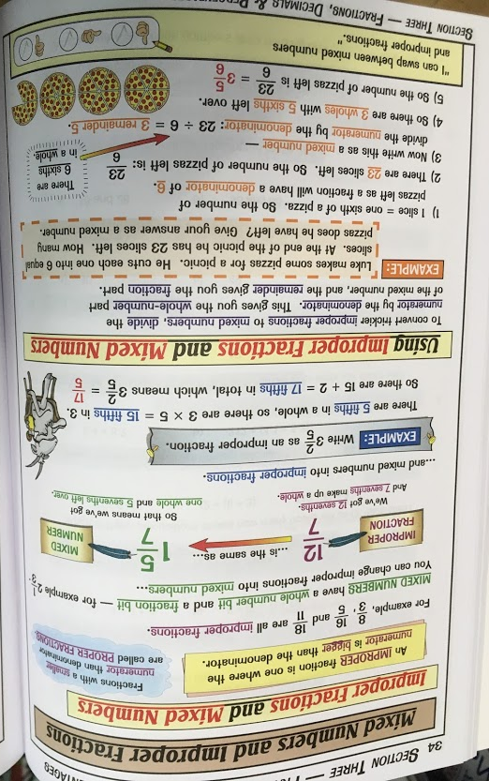
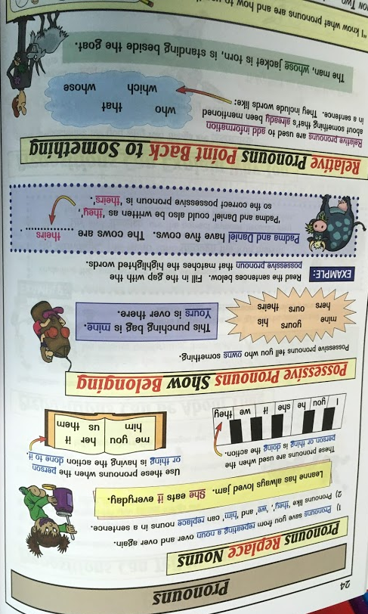
End of Key Stage SATs Information Afternoon

Slide 20
Things to look out for
End of Key Stage SATs Information Afternoon
KS2 SATs
Topic – Reading, SPAG or English GPS, Maths
Difficulty of book – Expected Standard or Greater Depth
Type of book – Revision booklet, practice questions or past papers.

Slide 21
SATs run through
End of Key Stage SATs Information Afternoon
Next week
Try to keep everything the same as the real thing
Seating

Slide 22
Revision
End of Key Stage SATs Information Afternoon
Easter Packs
Little and often
Covers SPAG, Reading and Maths

Slide 23
Advice for children
End of Key Stage SATs Information Afternoon
Try their best.
Read questions and instructions carefully.
Pace themselves.
When checking answers, do it really carefully.

Slide 24
During the week
End of Key Stage SATs Information Afternoon
Ensure that they get a full night’s sleep.
Make sure that they have breakfast.
Send/bring them to school so that they arrive in good time and properly equipped, including a healthy snack.
Check the test timetable.
CONTACT THE SCHOOL IMMEDIATELY IF YOUR CHILD IS UNABLE TO ATTEND SCHOOL 01483 421597

Slide 25
What happens if my child is really ill?
End of Key Stage SATs Information Afternoon
They stay tucked up in bed until they are better.
If they recover within 5 school days of the test they miss, they can still take it when they return - they are not allowed to be in contact with any other child (in person or on phone/internet).
If they take longer to recover they will not be given a SATs level for any subjects they miss.

Slide 26
Results
End of Key Stage SATs Information Afternoon
July 2019
They will be published with the End of Year Report
Standardised Score | Met End of Year Expectations (EXS) | Greater Depth Standard (GDS)
Tests scores are turned into a standardised score between 80 and 120 | 100 – 109 | 110 or above

Slide 27
Link to past papers
End of Key Stage SATs Information Afternoon
www.satspapers.org.uk

Slide 28
SPAG and Maths definitions booklets
End of Key Stage SATs Information Afternoon
Please collect one from the back as you leave.

Slide 29
We are around for any questions.
End of Key Stage SATs Information Afternoon

